Slide 1

Setting Up a Development Server

Slide 2
Development server
A development server is a type of server that is designed to facilitate the development and testing of programs, websites, software or applications for software programmers. It provides a run-time environment, as well as all hardware/software utilities that are essential to program debugging and development.

Slide 3
Objectives
Server-side web experience
Test the results of your work
Test your web particularly when we start using JavaScript, CSS, and HTML5
You should also have an instance of every major web browser running on some system convenient to you.

Slide 4
What Is a WAMP, MAMP, or LAMP?
WAMP → “Windows, Apache, MySQL, and PHP,”
MAMP → “Mac, Apache, MySQL, and PHP,”
LAMP →“Linux, Apache, MySQL, and PHP.”
These abbreviations describe a fully functioning setup used for developing dynamic Internet web pages.
Note:
WAMPs, MAMPs, and LAMPs also come in the form of a package that binds the bundled programs together so that you don’t have to install and set them up separately.
This means you can download and install a single program, and follow a few prompts, to get your web development server up and running in the quickest time with a minimum problems.

Slide 5
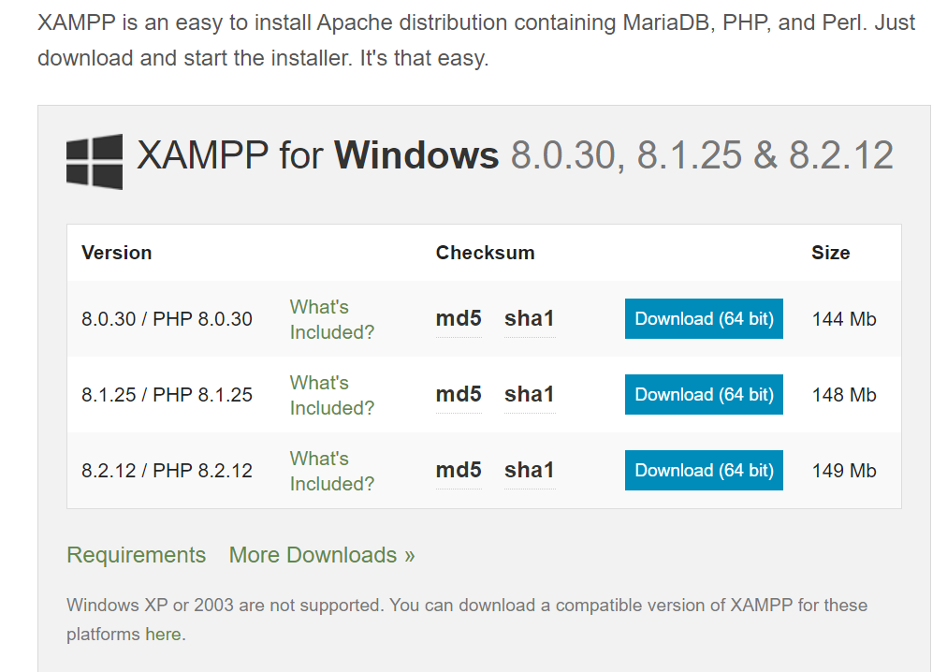
Installing XAMPP on Windows
There are several available WAMP servers, each offering slightly different configurations, but out of the various open source and free options, the best is probably XAMPP.
You can download it at https://www.apachefriends.org/download.html

Slide 6
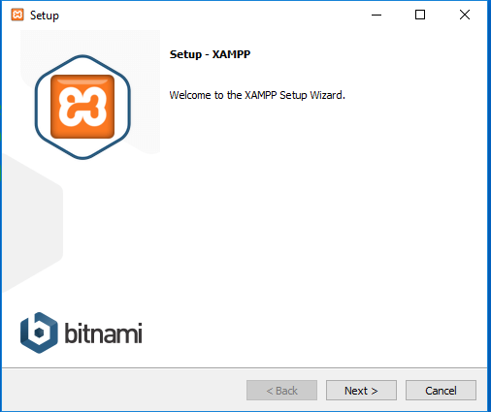
The minimum you will want to keep Apache, MySQL, PHP, and PHPMyAdmin checked.

Slide 7
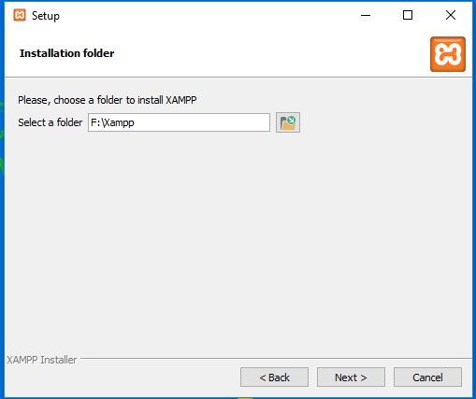
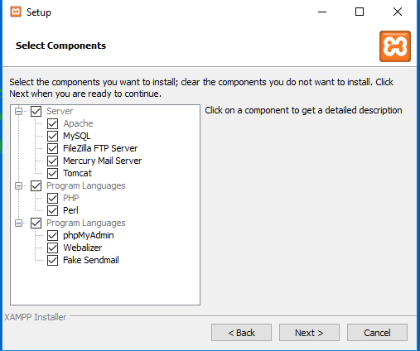

Slide 8
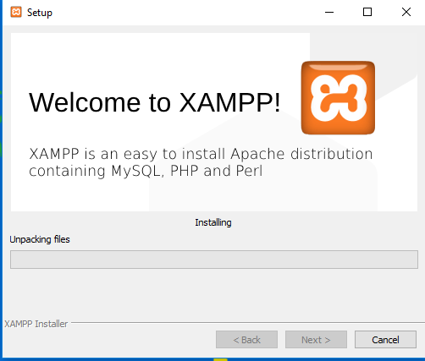
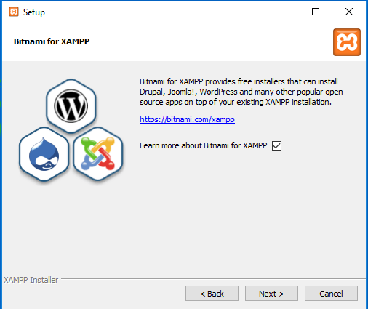

Slide 9
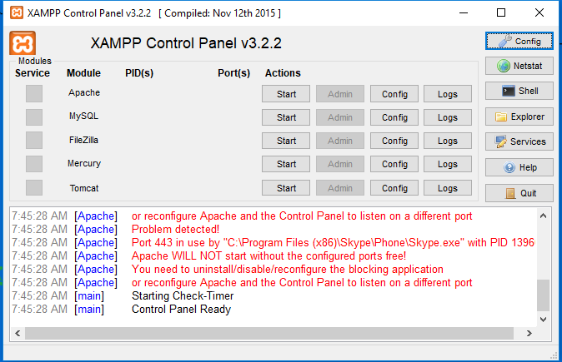
Instructions and XAMPP Control panel

Slide 10
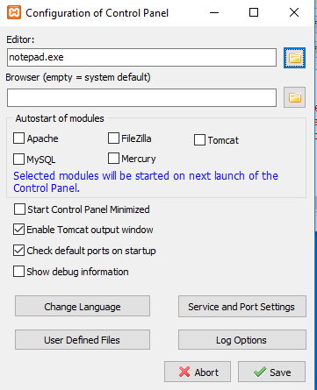
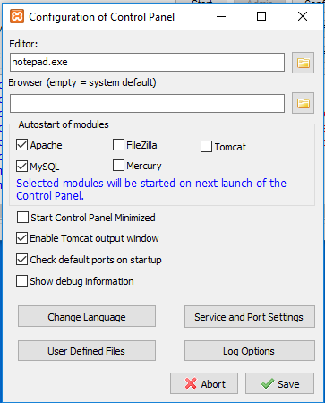
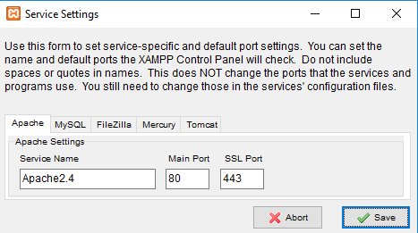
While on that screen,
Select Apache, MySQL then you may find that you also wish to change the port settings used by clicking Service and Port Settings to call up the window

Slide 11
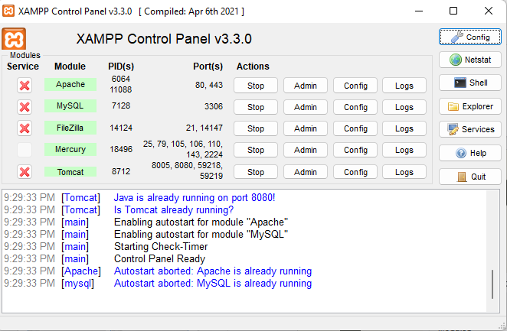
How to run?

Slide 12
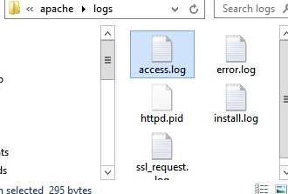
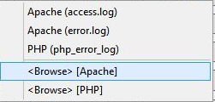
Click on the Apache log button

Slide 13
Ports:
The default ports assigned will normally be port 80 for the Apache web server, 443 for SSL, and 3306 for MySQL.
The control panel is where you can conduct most of the actions required for managing XAMPP, including editing and viewing the various configuration files, and looking at access, error, and other log files, all with a simple interface.

Slide 14
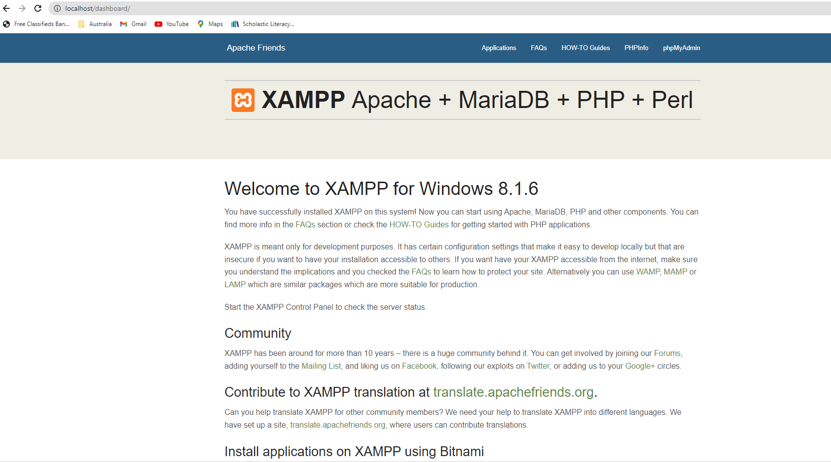
Testing the Installation
The first thing to do at this point is verify that everything is working correctly.
To do this, you are going to try to display the default web page, which have been saved in the server’s document root folder.
Enter either of the following two URLs into the address bar of your browser:
localhost /dashboard/

Slide 15
Accessing the document root
The document root is the directory that contains the main web documents for a domain.
This is the one that is entered when a basic URL without a path is typed into a browser, such as
http:// yahoo.com or, for your local server, http:// localhost. By default, XAMP uses the following location for this directory: C:/ xampp/ htdocs

Slide 16
Hello World file
To ensure that you have everything correctly configured, you should now create the obligatory “Hello World” file.
So create a small HTML file (at any location for now) along the following lines using
Windows Notepad or any other program or text editor (Like how you create HTML files)
<!DOCTYPE html>
<html>
<head>
<title>A quick test</title>
</head>
<body>Hello World , This is test from Web dev server XAMPP!</body>
</html>

Slide 17
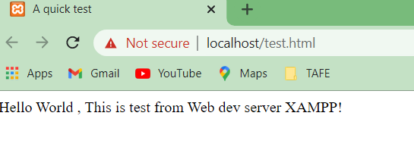
Root Directory for XAMPP is :
C:/xampp/htdocs
Once you have typed this, save the file into the document root directory previously discussed, using the filename test.html.
If you are using Notepad, make sure that the “Save as type” box is changed from “Text Documents (*. txt)” to “All Files (*.*)”.
Or, if you prefer, you can save the file using the .html file extension; either is acceptable.
You can now call this page up in your browser by entering one of the following URLs (according to the extension you used) in its address bar (see Figure 2-14):
http://localhost/test.html

